Slide 1
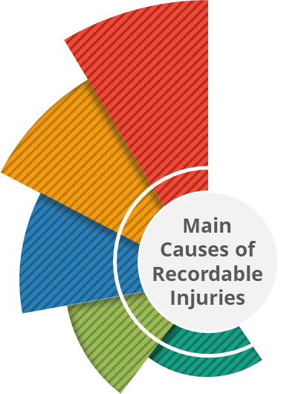









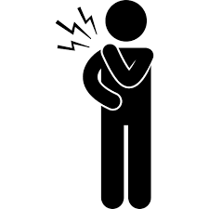

Switch on for Safety
Returning to the workplace after a holiday or time away, means returning to a safe mindset!
Why is this important
The choices we make today, determines our tomorrow!
Our Health & Safety (H&S) is a collective responsibility, let’s shape a better tomorrow by committing to being great safety leaders no matter our role or level.
Returning to work can be challenging. Our minds may still be in “holiday” or “home” mode, which means we are less alert to workplace risks and hazards and more susceptible to injury during this period.
We need to consciously switch our mindset and be fully focused on the job or task at hand.
We can all be safety leaders and play our part by:
Always speaking up
Stopping the job if I feel it is unsafe
Contributing to risk assessments and continuous improvements
Challenging unsafe behaviours or workplace conditions.
Recognising and praising positive H&S performance and behaviours.
Did you know in 2023 the main causes of our recordable injuries were...
To be safe, I will simply focus on…
My Training
Am I trained to do my current job?
Do I need refresher training or coaching?
Have I updated my certificates or my permits to work?
Have I checked my learning record and enrolments for overdue or upcoming training?
Can I enrol in safety training on myUNSW, and find enrolled or completed courses on Moodle?
Safe Ways of Working
Do I need to refresh any key procedures or processes?
Are there any new procedures or processes I need to be aware of?
Have I completed my risk assessment?
Can I identify improvements in our ways of working?
Have I discussed any aspects that aren’t practical, are difficult to access, use or apply, with my Line Manger?
My Tools, Equipment and PPE
Do I have all the PPE or equipment to do my job safely?
What is the condition of my PPE or equipment? Does it fit correctly?
Do I need to order or replace any items?
Have I set up my workspace ergonomically?
Have I completed or refreshed my ergonomic risk assessment?
My Body and Mind
UNSW wellbeing page
Am I mentally and physically fit to do the work?
What will I do to focus on my own mental and physical health this year?
Do I know how to access the EAP (Employee Assistance Program) service?
Do I know how to contact the First Aiders and Mental Health First Aiders at work?
My Team
Have I reconnected and checked in on my workmates, especially those working remotely?
Am I comfortable to speak up about unsafe behaviours I might observe?
Slip, trip and fall
Hitting objects with a part of the body
Take Action!
Take Action!
Take Action!
Take Action!
Take Action!
Hitting by moving object
Check your mandatory training enrolments
Verify your competencies and certificates
Refresh on all relevant procedures or processes in Salus
Identify any documentation that needs reviewing with your manager
Visit UNSW Safety homepage for documents and resources
Submit any PPE or equipment orders urgently
Conduct or refresh your workstation Ergonomic Risk Assessment for onsite or remote working
Check the quick guide on supporting psychosocial safety
Find resources on UNSW wellbeing page
Book an appointment with the UNSW Health Service
Report hazards and incidents in Salus
Download the SafeZone app to get assistance in an emergency
Body Stressing
Sharps
If you are not sure about anything, please speak to your Line Manager or local Safety Team

