Slide 1

Get the most out of Copilot Chat
Cheng-Yi Lin, ADA Educational Development Team

Slide 2
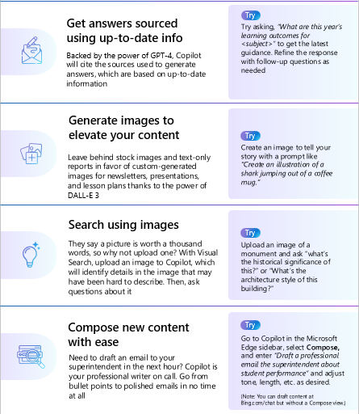
Tips to make the most of Copilot for Academics

Slide 3
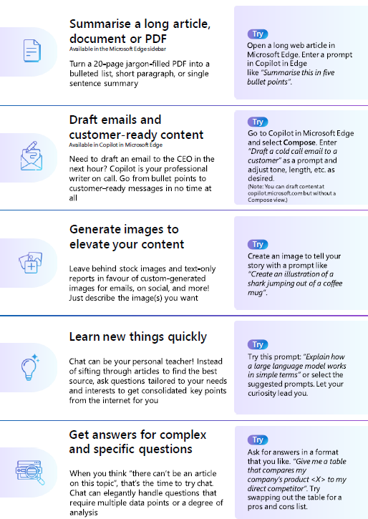
Tips to make the most of Copilot for professional staff

Slide 4







When to chat
When your day looks like this...
Try this
You searched and found some great articles, and you want to quickly make sense of them
"Summarise this content...“
You collected ideas from different web pages and you're ready to write them up as an email or report
"Write an email based on these bullet points..."
You can't find stock images that match your presentation, or your document has no images
"Create an image like this….“
You pulled up blog posts and videos to learn something new, but you learn best by asking questions
"Explain this..." Or "How come...“
You've got multiple articles with different perspectives on a topic, so you still can't make a decision
"Compare this option and another option in a table" or "Give me the pros and cons of..."

Slide 5
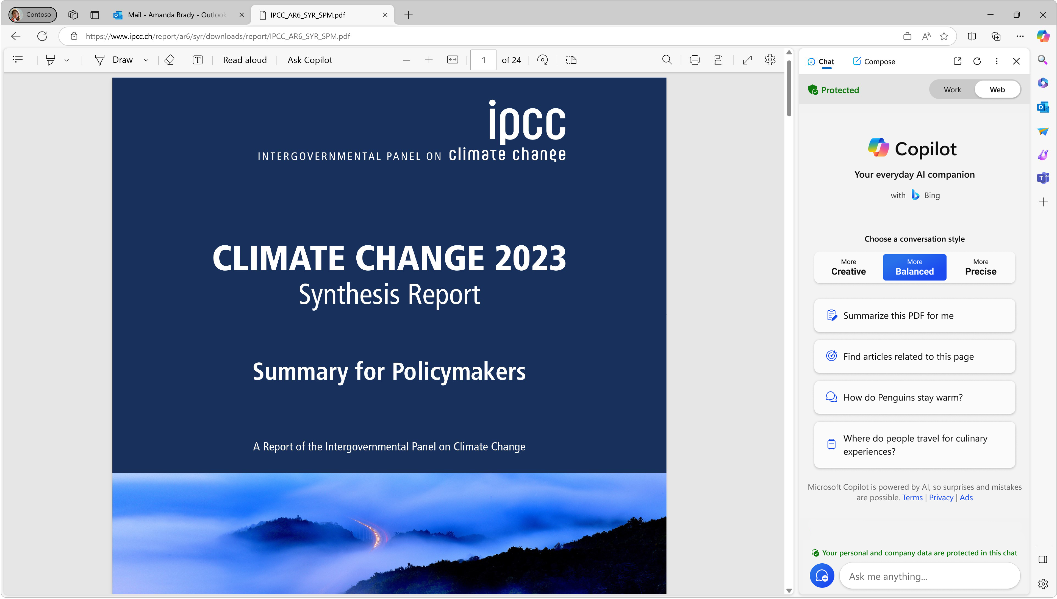

Try summarising a web page, PDF, or document
Only available in Microsoft Edge
Open a PDF in the Microsoft Edge browser, then:
At the top right, select the Copilot icon
OR
Select the “Ask Copilot” button in the taskbar above the PDF
The Edge sidebar will appear on the right. Enter the prompt: Summarize this report in 3 bullet points
You can ask questions about the open tab—which is much easier than copy and pasting a web page or PDF into the text box!
2
1
1
2
3
3
Note: Select the Copilot icon to open or close the Edge sidebar.
If Edge sidebar doesn’t work for you, please see sidebar settings guidance in the “Additional Resources” section of this guide.

Slide 6
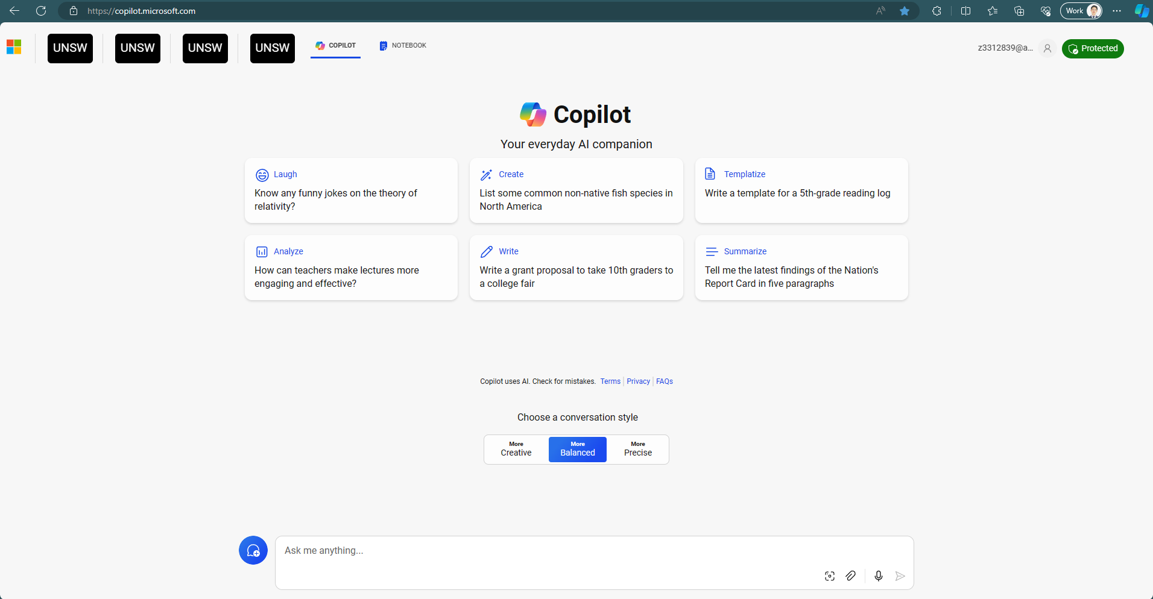
Try writing an email based on web content
Copilot can help you get a jumpstart on finding information, analysing data, and creating new content.
Let’s try summarising some content:
Enter this phrase, “Summarise this content in 3 bullet points:” into the text box
Select any company content that’s at least a few paragraphs long like a blog post, section of a report or document, etc.
Copy and paste that content into the text box at the bottom. This is now part of your prompt
Next, try creating some content based on Step 1. Enter in the text box, “Create an email that explains the content I provided as a casual email to a colleague”
Copilot.microsoft.com
Note: Make sure you are signed in with your work account. Verify that you are in the protected Copilot experience before you start.

Slide 7
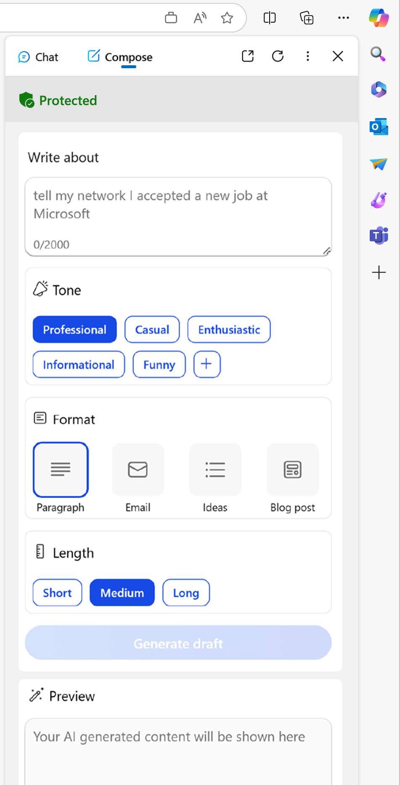
Try the Compose template to create professional and course-ready content
Only available in Microsoft Edge
Open the Microsoft Edge sidebar by selecting the Bing icon in the top right corner of the browser
Select “Compose” at the top of the Edge sidebar
1
Enter your prompt in the text box. Example: Write a cold call email to offer a 15-minute product demo. Explain that the product is faster and cheaper than what they’re using now
2
Select the tone of the wording (professional, casual, etc.), format, and preferred length (short, medium, long, etc.)
3
Once you see a preview of your answer in the lower box, refine the content with the suggestions provided. When you’re ready, Select “Add to site” to paste the content into the open web page or document on the left side of browser
4

Slide 8
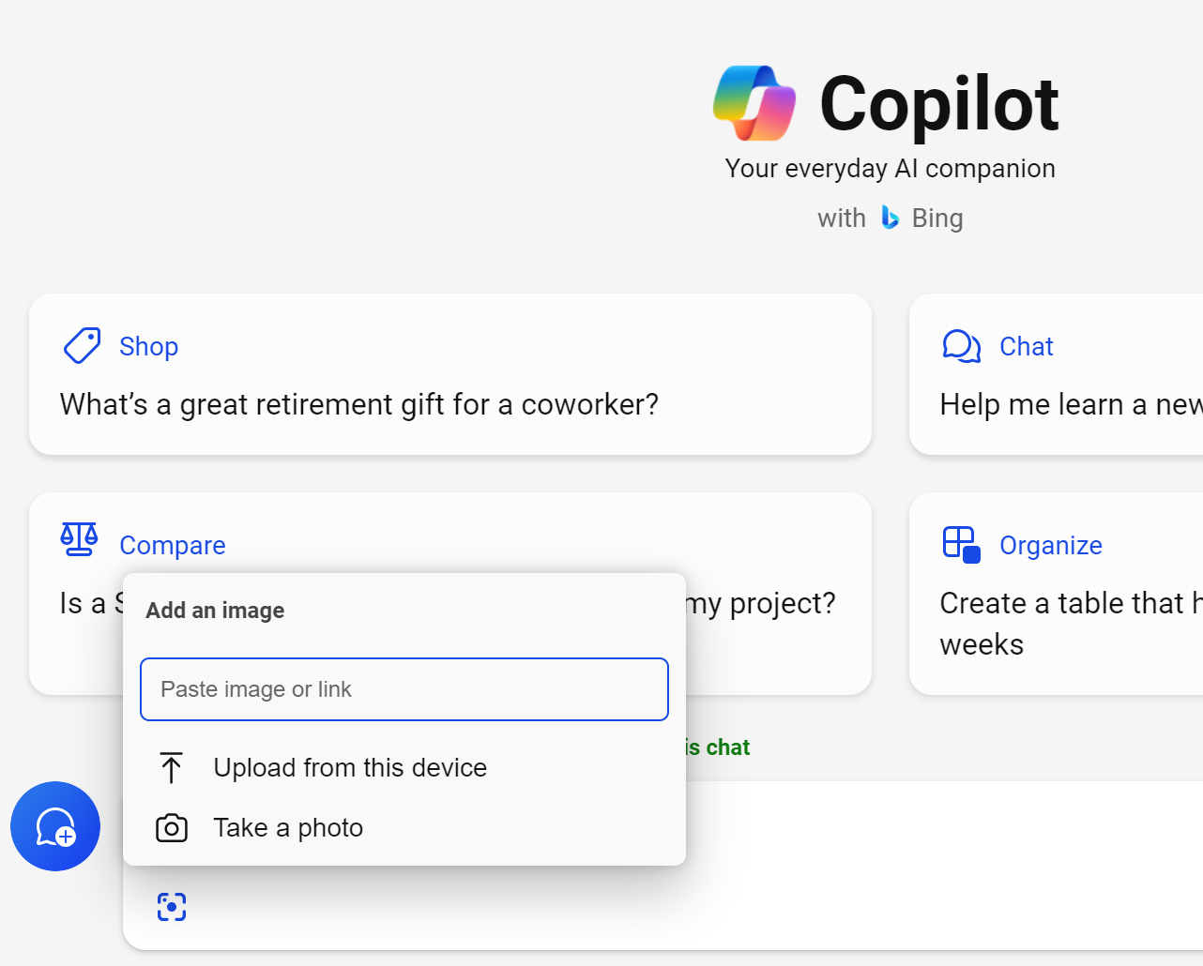
Try a visual search when words are not enough
With visual search in Copilot, you can take a picture or use a picture in a prompt. Copilot can answer questions using the picture.
Try using visual search to:
Take a picture of a chart you drew on a whiteboard and ask Copilot to write a few sentences analysing the data in the chart.
Take a picture of a travel adapter to see if it'll work in the country you plan to visit.
Snap an image of a product and ask visual search to find the instruction manual for it.

Slide 9
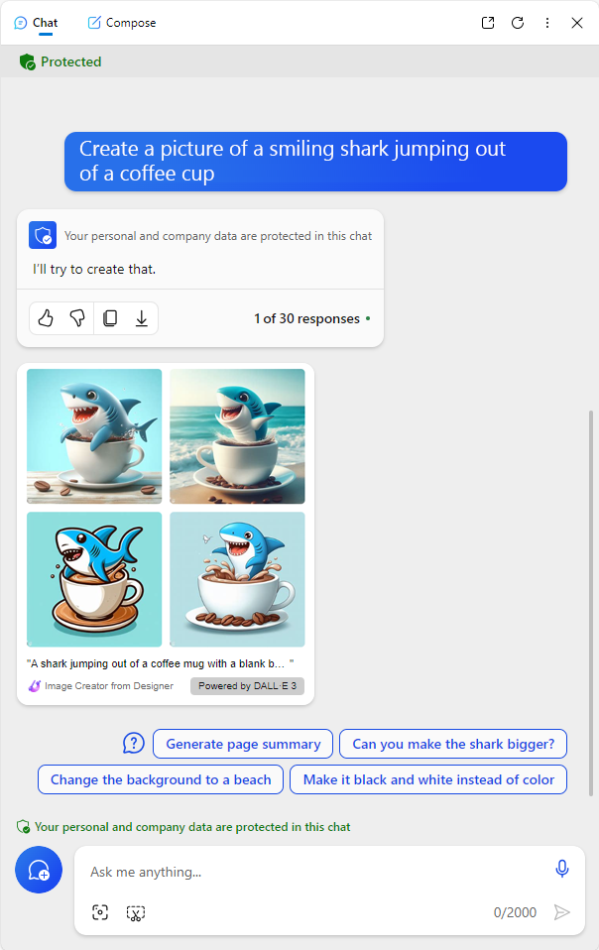
Try creating an image from your imagination
Generate original images to use in social media, presentations, reports, and more! To create an image:
1. In the text box, write "Create an image" followed by a description of the image you wish to create
Examples:
Create an image for my slide deck explaining cloud storage that I will present to a customer
Create an image that I can use for my next marketing campaign for a clean beauty brand
2. Request additional edits as desired
Examples:
Add some icons to the image
Can you create the images in a cartoon style?
Change the dimensions
"Create an image of a shark jumping out of a coffee mug"

Slide 10





Workday efficiencies with Copilot
Copilot is the new way to search…and more
Summarise a long PDF
Draft emails and social content
Generate
images
Get answers for specific and complex questions
Learn new skills
Turn a 20-page, jargon-filled PDF into 5 bullets using Copilot in Edge
Use Copilot as your professional writer on call to draft emails, captions, and more
Leave behind stock images and text-only reports in favor of custom-generated images for emails, on social, and more
Ask questions tailored to your needs and interests to get consolidated key points from the internet for you
Elegantly handle questions that require multiple data points or a degree of analysis

