Slide 1



DIIU Forum 2025: Diversity in Disability Inclusive Research

Slide 2

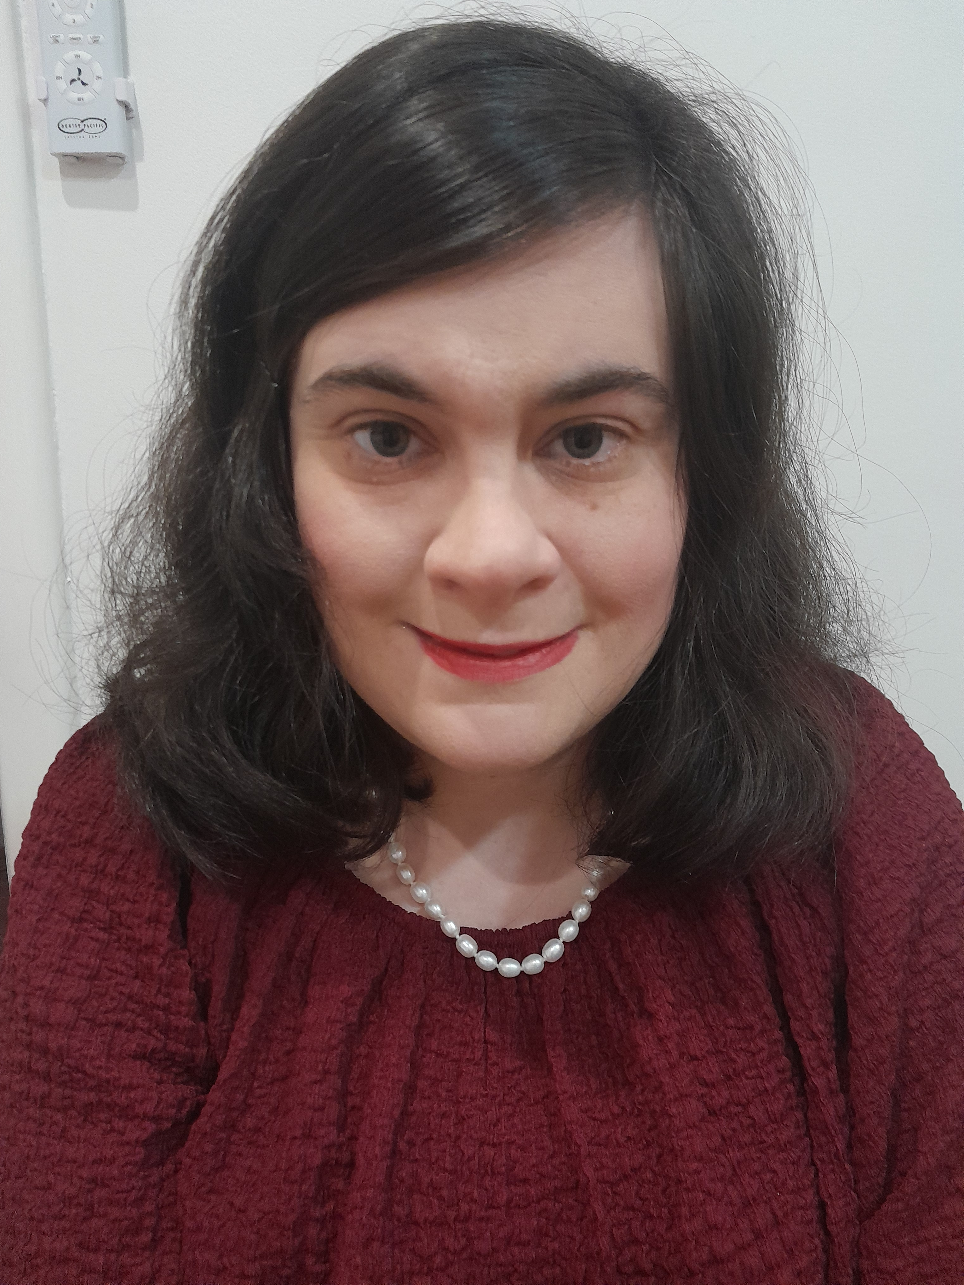

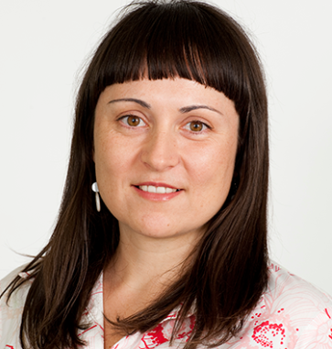
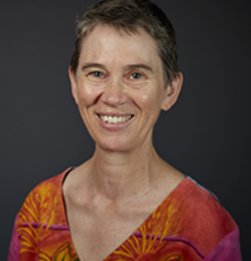
Introduction
The research team
Sandra Gendera Jala Burton Karen R Fisher
Notes:
Sandra Speaking,
1. We are an inclusive team and work together online.
2. We have worked together online more than 3 years.
My name is Sandra Gendera
I am a disability and MH policy researcher at UNSW, I am wearing a bright # Red.
Jala introduction:
Kaurna land, Jala, hair length and colour, significant physical disability study background and degree, policy research UNSW.

Slide 3




Transformation of Closed Employment. Rapid Evidence Review
Image or illustration related to the topic goes here
Notes:
Sandra
Today Jala and I are presenting from a project Transformation …

Slide 4


Terms we use…
Closed employment models
Sheltered workshops
Australian Disability Enterprises (ADEs)
Notes:
Today we use 3 terms in our presentation
Closed Employment models
Sheltered Workshops
Australian disability enterprises (ADEs)
These 3 terms refer to similar types of employment models
Different terms are used in different countries
Main Characteristics of Closed Employment models are,
1. their workplaces are separated from community
2. Majority of people who work there live with ID
3. Many people do repetitive tasks, have little choice about what they do
4. Closed Employment means lower than minimum wages
5. Limited opportunity to go further at work, some models include training opportunities.

Slide 5
Purpose of the review
Australian Disability Enterprises (ADEs) unjust pay, working conditions
Review question,
Can closed employment systems transition to achieve economic participation rights for people with intellectual disability?
Design and planning stage of the review
Notes:
Received funding
internationally and Australia - Policy commitment is to close all ADEs/Closed employment models.
ADEs still employ ~20,000 people ID- Woking conditions are poor – pay is unjust
So with this review we set out to examine the Transition of CE into more integrated employment models.
the main review question… was….
--- Jala - design & planning and why it was important
Aim - come to a shared understanding with the funders
Inclusive research team and funders joined online on numerous occasions to:
- Converse and deliberate together so that everyone could have their say.
Listening and hearing ideas
Never forget the people in the communities we are doing our work for and why we are undertaking research.
The How and the What of what we do.
This is so we stay true to our research and work being about “real people and real lives”
What we do isn’t just statistics and literature – Everyone has the right to:
1) Community inclusion
2) Adequate paid work

Slide 6
How we worked together
Regular team meetings
Clarify scope of the review
Develop and refine questions
Comment on early findings
Refine review reports
Notes:
Reflect – Sandra
Work collaboratively on each part
Use teams video calls, work online
All involved in all stage of the review – writing/ refine report.
HAND OVER - Jala, What were important aspects for you to working in an inclusive team?
Jala,
There are several qualities, which are valuable for me when it comes to, working in an inclusive research team.
These are:
Working together being a safe space,
There being time dedicated thinking and sharing.
Valuing one another’s ideas
Having opportunities to create scope for concepts.
Drawing out the ‘value’ of such ideas and concepts.
The ability to speak our minds, our truths, and be ourselves during our online work meetings together, including with funders.
Sandra
Bring our work and life experiences and expertise together to creatively problem solve
Example:
When we received the project brief from the funder, the emphasis was on ADE transition.
The rights of people with disability were only implied.
Designing the project with the lived experience team meant we could vividly discuss with the funder why making human rights (the Right to Work) explicit, was central to the research questions.

Slide 7
Lessons about transformation of closed work
Employment in community is possible
On-the-job training and personalised employment support works
Diverse partnerships are needed
Community and diverse alternatives
Policy commitment
Notes:
Jala
People with intellectual disability can have jobs in the community.
On-the-job training and personalised and tailored employment support – are what works best.
People with intellectual disability, including school leavers need to be linked to career pathways.
This involves necessary Diverse partnerships (schools, post-school training providers, and employers).
Community Alternatives
people with disability have their reasons, why paid work is not for them.
Community inclusion is key, other forms of contributions like volunteering also warrant respect.
Sandra –
We found…Transformation and Closure is possible –
Example. United States. In 2019, Out of 50 states 19 were no longer funding closed employment,
at very low levels (1-2%)
Commitment to closing Sheltered Workshops requires - Policy priority and a timeline.
ANYTHING ELSE YOU’d Like to add Jala?
Accountability.

Slide 8
Reflection: Doing inclusive research
Diverse perspectives and expertise
Teamwork develops over time
Shared learning
Growth
Prioritise people with disability
Notes:
Jala (start)
Reflections why its important inclusive team
Jala – working as inclusive team…
Combination of different expertise. Bring the best out in ourselves and in each other
We have worked together for a long time, across many projects.
We have got to know each other. Trust.
We have learnt a lot and still have more to learn.
Personal story - ….when ...“Jala story”.
Sandra –
Main things that stood out for me…
We laugh a lot more when we are together.
Saying things differently, helped the lived experience team raise “uncomfortable questions
Influenced how we framed our questions – “on Right to Work and on Systems change”.
This ensured the Priorities of PWD are at the centre of this review.
Hand over to Jala – anything else?
Jala
Heart of this People with Intellectual Disability….

Slide 9
Your questions answered
Thank you!
If you are interested to learn more about the work on the
future of disability employment by this team,
Transformation of closed employment: Rapid evidence review
Road to Employment
https://www.unsw.edu.au/research/sprc/our-projects/road-employment-evaluation
DREAM Employment Network
https://www.unsw.edu.au/research/sprc/our-projects/dream-employment-network-program-evaluation
Notes:
Jala introduce questions

Slide 10
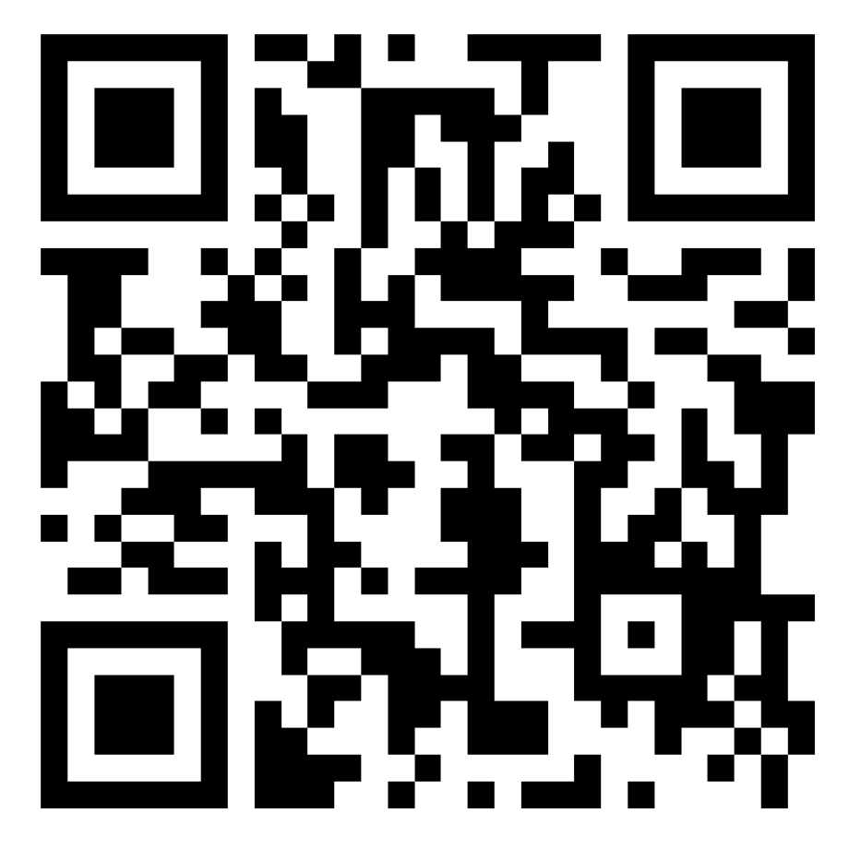

Thank You
​
Short feedback survey:
Contact Us
diiu@unsw.edu.au

