Slide 1
COMMUNITY CONSULTATIONS USING RECIPROCAL RESEARCH:
Working with interpreters, the most important members of the team
Notes:
Trained and highly skilled interpreters are expensive, and often not available when where we need them.
Generous community members and local stakeholders often step in to do the interpreting. A good facilitator will need to meet with them before the sessions, to ensure that they understand the way in which they are required to work, and that they are familiar with the specific language being used.
It is clear that the facilitator and the interpreter understand the correct format for good interpreting. The Facilitator is in charge of the session, and should never stand behind the interpreter. The facilitator should also speak in the first person and instruct the interpreter to translate. They are your voice, your language interpreter, but not your content interpreter. Stress they must try and say exactly what you have said. They must never take charge of the session.
Only speak fro a couple of sentences at the most before they interpret for you.
Speak slowly and clearly
Never say “Tell the (the participants) this …..
Never ask the interpreter “What did they say? Ask the participants what is happening

Slide 2
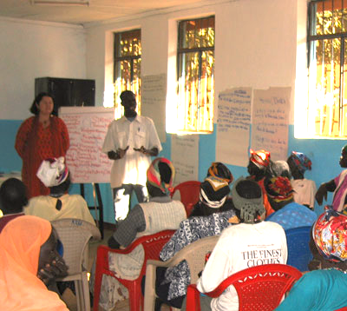
Good interpretation is critical to a successful consultation.
If the interpreter does not interpret correctly then the consultation can fail.
Trained interpreters are not always available.
It is the responsibility of the facilitator to ensure that the interpretation is effective.
Notes:
If the interpreter is obviously explaining something you have said, stop them, ask what the problem is. If they have nor fully understood, you have no idea what is being said to the participants.
Check what the interpreter is saying with the body language of participants. If it does not match, ask what is happening.
If you or a participant have spoken a couple of sentences and the interpreter says two words, check what is happening.
If the interpreter is talking a lot, ask them what they are saying.
It might take the facilitator and the interpreter some time to get used to working like this
It is worth it. Poor interpreting can be very disruptive or even dangerous.
Pre Requisites for the Interpreters
It is acknowledged that it is often difficult to find appropriate interpreters in some circumstances, post disaster and in remote communities. The following criteria are therefore desirable rather than essential

Slide 3
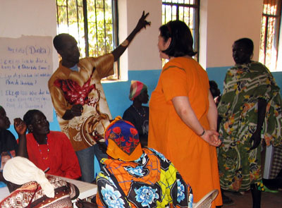
If Possible interpreters should:
have experience working as an interpreter
be literate in the language they are interpreting
have the confidence of the participants in the training
have experience in translating gender issues
be comfortable discussing issues such as sexuality
Notes:
Whenever possible the interpreters should:
have experience working as an interpreter
be literate in the language they are interpreting
have the confidence of the participants in the training
be a woman if women form the majority of the community
have experience in translating gender issues
be comfortable discussing issues such as sexuality
be prepared to do preparatory work with the facilitators and to attend briefing and debriefing session before and after each days work
go through all of these things with the interpreters before the sessions.

Slide 4
The Interpreter’s Role
They are the main communication channel for the facilitator and the participants. It is critical that they:
must translate exactly what is said.
must speak in the first person - they are translating not speaking on behalf of the facilitator or participants.
must not censor what is said
must not change the interpretation to suit their point of view
must not be afraid that the facilitator will be offended by what is said and refuse to translate it.
Notes:
Briefing the Interpreters
The quality of the interpreters will have a big impact on the effectiveness of the training, and the learning outcomes for the participants. The qqquality of the briefing you give can make all the difference. The interpreters may not be comfortable with some of the material which is presented or discussed, and may not be familiar with participatory and interactive training . It is therefore important that the go through the materials with them, especially if it is very technical, or very sensitive.
Occasionally interpreters have said things like “her boyfriend” instead of “her rapist”.
These are the sorts of things you need to try and avoid, as it gives a very different message than the one intended.

Slide 5
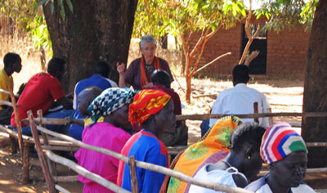
The Interpreter’s Role
Additionally you will need them to:
Write the key points of discussion onto flip charts in their own language.
Do some translation of written materials
Have a brief meeting with the facilitators each morning to plan the days work and each evening to discuss any problems.
Notes:
It will be useful if the interpreters can assist by writing some of the key points of discussion onto flip charts in their own language. It is good to have a brief meeting with the interpreters each morning to plan the days work and each evening to discuss any problems which might have occurred. If the material discussed has been of a traumatic nature, it is essential that the interpreters be given the opportunity to talk about their feelings before they leave.
If they are very upset, it may be necessary to provide them with counselling.

Slide 6
The Facilitator’s Role
The facilitator must always have control of the conversation.
The interpreter must not stand in front of or between the facilitator and the participants.
The facilitator must speak to participants in the first person and prompt the interpreter always to translate in the first person.
The facilitator must not ask the interpreter what the participant means – they must ask the participants.
The facilitator must not allow conversation between interpreters and participants – it must all go through the facilitator.
Notes:
Potential problems can be identified, and the meaning of key words and phrases can be explained. It is important to form a dynamic teaching team. The interpreters have to feel comfortable to be able to tell the facilitators to slow down, to use shorter sentences, or to say that they do not understand what has been said. The facilitators need to feel comfortable to ask the interpreters to restate something if it is obvious from the reaction of the participants that there has been a misinterpretation.

Slide 7
A good facilitator:
says the same things in several different ways to make sure that the interpreter understands what is being said.
watches for body language to check meaning.
does not use slang or jargon.
speaks slowly and clearly.
uses lots of body language and facial expression.
If the interpreter falters, the facilitator should check that they have explained what they are saying clearly.
Notes:
Good luck, and remember the interpreter is your voice, but is not a facilitator.
Always remember to thank the interpreter publicly at the end of the session. It is a difficult job, especially if they are not professionally trained.

