Slide 1
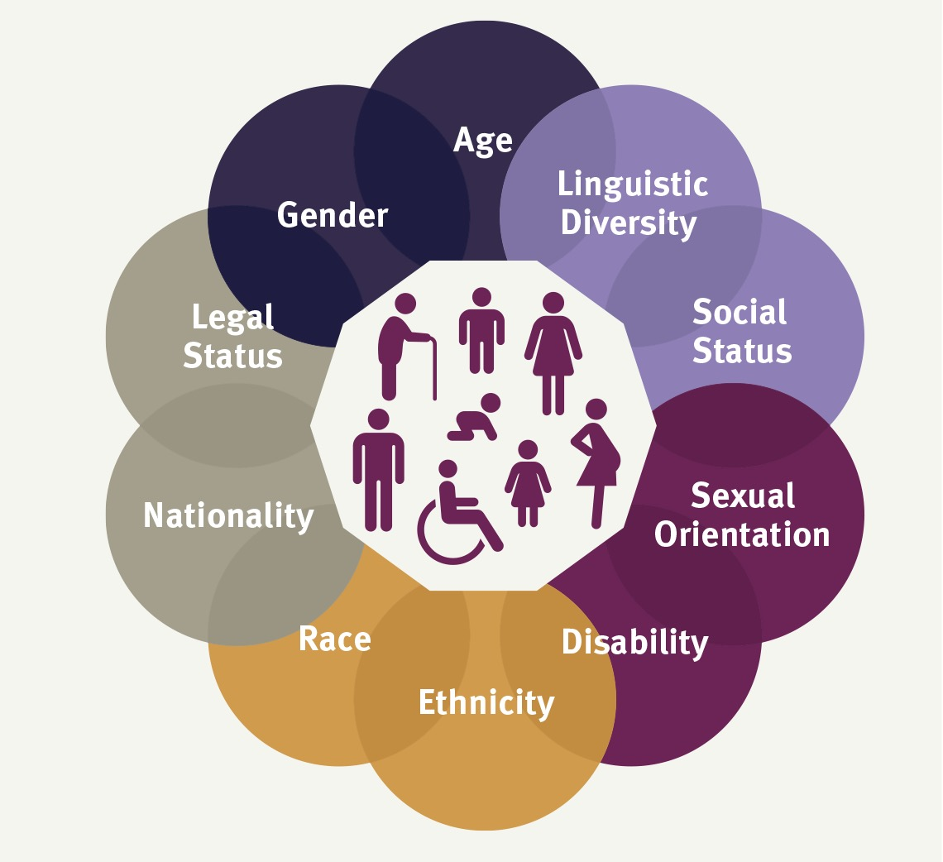
Module 1: What are ‘intersectionality’ and the ‘Age, Gender and Diversity’ approach?

Slide 2

Welcome and introductions

Slide 3
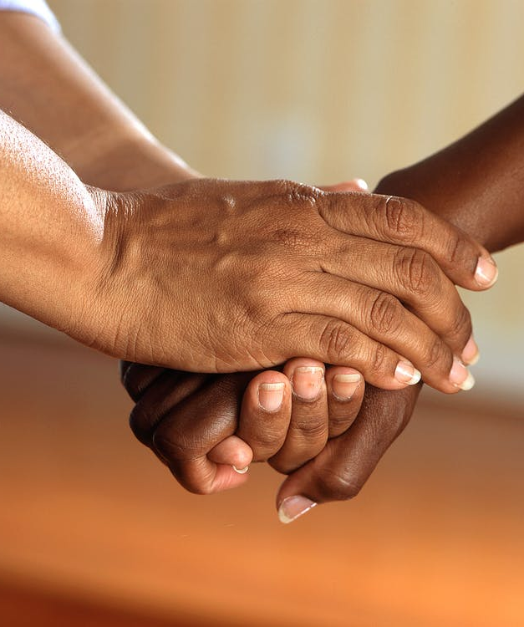
Confidentiality
Confidentiality is important because it helps to build trust and create a safe space for open discussion.
It is the commitment that no personal opinions or stories shared during this training will be discussed outside of this training.
Notes:
Activity - Presentation and group discussion
Introduce the idea of Confidentiality
Go around the group asking participants what “confidentiality” means to them
Prepare an example of what happens when confidentiality is broken
Discussion Points
Talk about the importance of confidentiality in this training and also as a leadership tool.
If people believe that that can share things in confidence it builds trust..
Good leaders respect confidence.

Slide 4
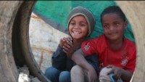
Part 1: Introduction to an age, gender and diversity and
intersectionality approach [UNHCR and UNSW]

Slide 5
What is ‘intersectionality’?
Intersectionality refers to the ways in which the different aspects of a person’s identity, what we will call layers, affect the way they are viewed by others and thus affects their life.
Originally it was used to describe the impact of multiple oppressions experienced by black women in the US.
It recognises that forms of oppression such as racism and sexism do not operate independently but intersect, compounding the impacts of each.

Slide 6
Intersectional strengths and vulnerabilities
Intersectionality recognises that intersecting and overlapping identities can be both oppressive and empowering.
Intersectionality creates both strengths and vulnerabilities in individuals.
Some of our identities help us to be resilient and productive members of our communities, but others lead to discrimination, marginalisation and oppression.

Slide 7
Example 1: The many layers of a refugee girl with a disability

Slide 8
Example 2: The many layers of an an elderly stateless refugee

Slide 9
Exercise: identifying intersectionality
Write a list of all of the identity labels that apply to yourself. Only include those you are happy to share with others.
In pairs, share your list and discuss which of your identities provides strength and which is a vulnerability.
Q1: Are some of your identity labels a source of both strength and vulnerability?
Q2: What are some examples of how your identity labels combine to increase your resilience or your vulnerability?
Q3: Have some of your labels led to discrimination? Which ones?
For example: age, gender, sexuality, cultural/racial heritage, profession, family status, health status, religion, citizenship, disabilities, talents and interests

Slide 10
What is ‘AGD’?
The Age, Gender and Diversity approach, or ‘AGD approach’ as it is usually called, is the cornerstone of UNHCR AGD Policy.
It recognises that like the rest of the world, people who are refugees, forcibly displaced and/or stateless, are very diverse.
They include people of all ages, genders, nationalities, religions, disability status, sexual orientation and gender identities, as well as national, ethnic, religious, linguistic minorities and indigenous peoples.

Slide 11
AGD Policy
The AGD Policy is designed to ensure that all diverse groups are treated equally. It commits to:
Inclusive programming to ensure that no one is left out
Providing opportunities for all refugees, forcibly displaced and stateless people to participate in decision making about their own lives
Providing women and girls equal access to documentation, and control over food and relief items and cash
Providing equal access to economic opportunities, work, education and health services.
Providing comprehensive prevention, response and risk mitigation services to address gender-based violence, including sexual violence.

Slide 12
Review activity
In pairs, write a definition of intersectionality and AGD policy in your own words and then share them with the large group.

