Slide 1
COMMUNITY CONSULTATIONS USING RECIPROCAL RESEARCH:
A Brief Introduction to Program Design
Notes:
This is a short introduction to Program Design. Its purpose is to introduce participants to the complexity of the process and hopefully to see that they can do it. It follows the Community Consultation Session.
Much more in depth training will be needed to support the full development of a Program, and a funding application.

Slide 2
Moving from Consultations to Program Design
Good consultations often lead to designing programs to meet the needs of the community, and applying for funding for these.
This is a brief introduction of the things you need to consider when designing a program.
Notes:
As above

Slide 3
Its important to clearly define your aim, objectives and strategies to:
articulate clearly to funding bodies exactly what needs have been identified
make sure that the participants are involved in and “own” any outcomes
Notes:
These are important steps to be taken as part of Consultation follow up.

Slide 4
The project aim is the broad goal
that your project will contribute to.
Notes:
Make sure that participants understand the difference between aims and objectives.
Have some examples of your own.

Slide 5
Example: To identify the major issues of concern to the group with whom you are working.
Aim:
To assist the groups to propose solutions to the problems they have identified and plan actions towards achieving these.
Notes:
Ask them to suggest other examples.

Slide 6
The objectives are the measurable outcomes
you intend to achieve by the end of the project.
There may be several different objectives
which all contribute to the aim.
Notes:
As above.

Slide 7
Aim:
To work with the community to identify risks and appropriate responses for them.
Objectives:
Clear identification and documentation of risks in a particular site
Identification of appropriate local responses
Strategic and action planning with key stakeholders
Notes:
This could also be used as a basis of a small group exercise, with each group developing an aim and objectives for an activity they would like.

Slide 8
The strategies are what you need to do to achieve each of the objectives.
Each strategy can then be broken down further
into a list of activities.
Notes:
In the same groups, they can now develop a list of activities to address the objectives, or you can give them some examples.

Slide 9
Aim:
To prevent and respond to sexual abuse in communities
Objective:
Better protection for women and girls in vulnerable situations
Strategies:
Locks on toilets, and bathing points
Lights at night
A confidential reporting point with follow up to complaints
Support groups for women who have been raped
A safe house in the locality
Notes:
Here is one example from a real application.

Slide 10
Your project aim, objectives and strategies should have an internal logic, so that when you look at them, the strategies describe everything that needs to be
done to achieve the objective, and the objectives all contribute to the aim.
Notes:
Explain how this goes both forward and backwards. Use the example above to do this

Slide 11
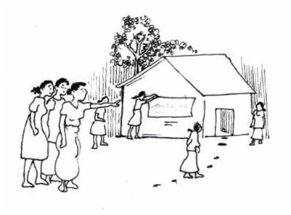
Fostering participation and ownership of services:
How are you going to get people involved in the planning and establishment of the projects
and services?
Notes:
Brainstorm with the participants how this might happen in the sites where they live and work.

Slide 12
OWNING A PROCESS THROUGH ACTIVE PARTICIPATION
Community members must be given every opportunity to plan and manage projects which meet their special needs.
The process must be consultative and ‘transparent’.
All stakeholders must be invited to contribute their ideas and to participate.
Notes:
This reinforces the importance of follow up meetings after consultations.

Slide 13

Ensuring that men and women from the community are supportive of the services and projects and not threatened by them:
How are you going to involve men so that they are
supportive of programs, without trying to take them over?
Notes:
See Including Refugee Men, Module 7 in this resource kit.

Slide 14
Moving Forward
These are things that evaluators and funders will be looking for when they assess funding applications.
If you are interested in designing a program, please complete Module 11, From Humanitarian Aid to Human Rights Based Community Development in this Resource Kit.

