Slide 1
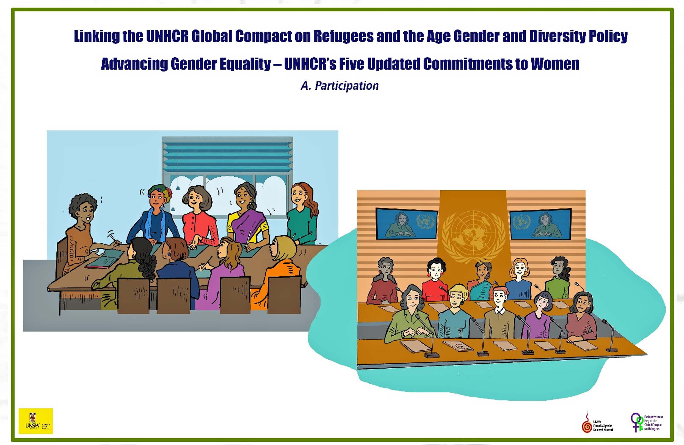
Session 8
Meaningful Participation
Developed by Eileen Pittaway and Linda Bartolomei, 2023 The Forced Migration Research Network UNSW
Notes:
Facilitators Notes
The Three ‘P’s - Participation, Partnership, and Privilege
We have found it useful to run the next three sessions sequentially, as they are different aspects of the same issue, the lack of meaningful participation by refugees and displaced people in the decisions which govern their lives.
Participation is a word that is widely used without a common definition. These can lead to disappointment and anger.

Slide 2
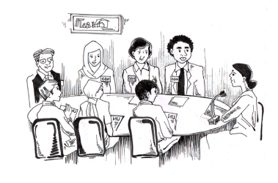
What is refugee participation?
When refugees — regardless of location, legal recognition, gender, identity and demographics — are prepared for and participating in fora and processes where strategies are being developed and/or decisions are being made (including at local, national, regional, and global levels, and especially when they facilitate interactions with host states, donors, or other influential bodies), in a manner that is ethical, sustained, safe, and supported financially.
The Global Refugee Network https://www.asylumaccess.org/wp-content/uploads/2019/12/Meaningful-Refugee-Participation-Guidelines_Web.pdf (page 7)
Notes:
Refugee organisations have made tremendous strides in achieving participation in some areas of the decision making that decides their futures, in particular at UNHCR and with some of the major donors and policy makers.
Some excellent training and tools have been developed by RLOs, see APNOR in Additional Materials.
We have identified that participation means different things in different contexts. Please see the background readings for rationale and examples.
The exercises in this module take an AGD approach to explore barriers to participation at all levels.

Slide 3
Social Inclusion
Social inclusion refers to the active and meaningful participation of refugees in the social, economic, cultural, and political aspects of the host society. It takes a human rights approach, treating refugees with respect, fostering a sense of belonging and empowering them to contribute positively to society at a local, national and international level, through their inclusion and advocacy (Kenny and Connors 2017: 30)
Notes:
For this project we have focused on the concept of participation from the ground up, starting within the family and up to the United Nations, for men and women, and people from all diverse groups.

Slide 4
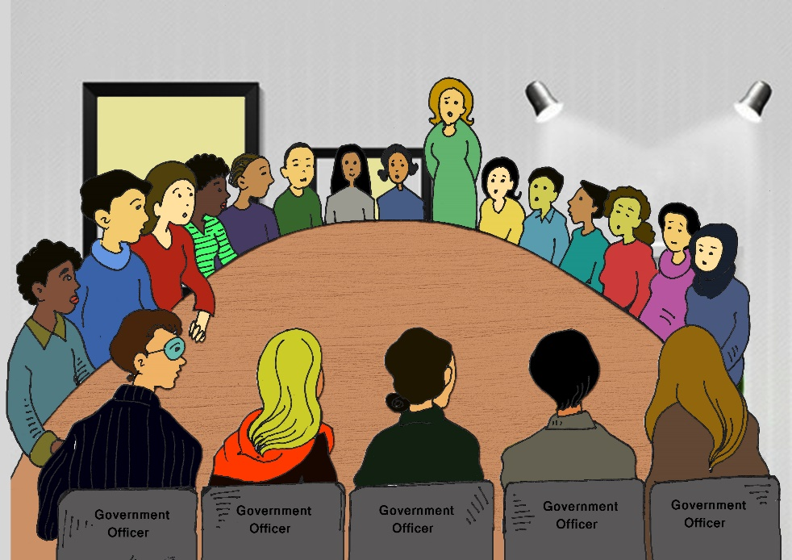
Spaces where people might want to participate in decision making and activities.
Family
Local community
Ethnic group
Refugee groups and organisations
In decision making with NGOs, UNHCR and other key agencies
In Government agencies
In Health services
Education
In employment
Other important places we might have missed.
Notes:
This list came from consultations with refugee women and men in Bangladesh, Thailand and Malaysia.
Participants might like to add other sites.

Slide 5
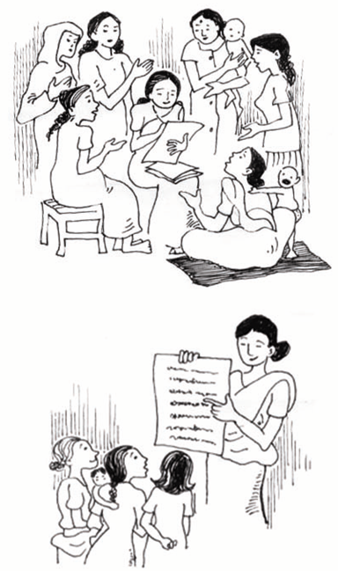
What can we do to make this happen?
Make sure that everyone has the chance to have their voice heard.
That it is real, not tokenistic
That people know this is their right.
That it’s not just for educated refugees.
That they know that what they have shared is important and will be included in your planning.
Look at barriers to participation.
Notes:
This is bringing together previous discussions about gender equality, lived experience, the impact of SGBV, the importance of including men in all activities and structural barriers.
Can participants suggest ways in which to cross these barriers.

Slide 6
We have examined many of the barriers to Participation that must be addressed.
Notes:
What do we need to do to get over the barriers?

Slide 7
A Checklist of local politics
Key things which need to be addressed when developing participatory approaches with refugee communities where you work:
Is the host government supportive or hostile?
Local politics – is the host community supportive or hostile?
Are authorities supportive or hostile?
What is the level of commitment to participation by the most powerful stakeholders?
Do the values, attitudes, capacity and resources of the local staff support participatory approaches??
If not, what, if anything can be done to address this?
Notes:
Check the exercises for this training module for suggested tools to explore these concepts. Tables to guide small group discussion can be downloaded, or pasted in the chat if training online.

Slide 8
Continued:
What role does ideology and culture, of refugees, hosts and service providers play in particular in sensitive issues such as human rights, including gender equality, and SGBV?
Are international agencies willing to co-operate together and work with local NGOs and refugee led groups as equal partners or does funding competition get in the way?
What is the level of trust between refugee communities, UN agencies and other service providers?
Is there fear that refugee-led groups are ‘too political’ and/or failure to accept that they can be both political advocates and rights-based service providers?
What political constraints are faced by local academic partners?
Are Donors willing to provide flexible funding?
Others?
Notes:
This is one on the exercises available in the materials. Depending on the time you have, choose the ones most suitable for your group.

Slide 9
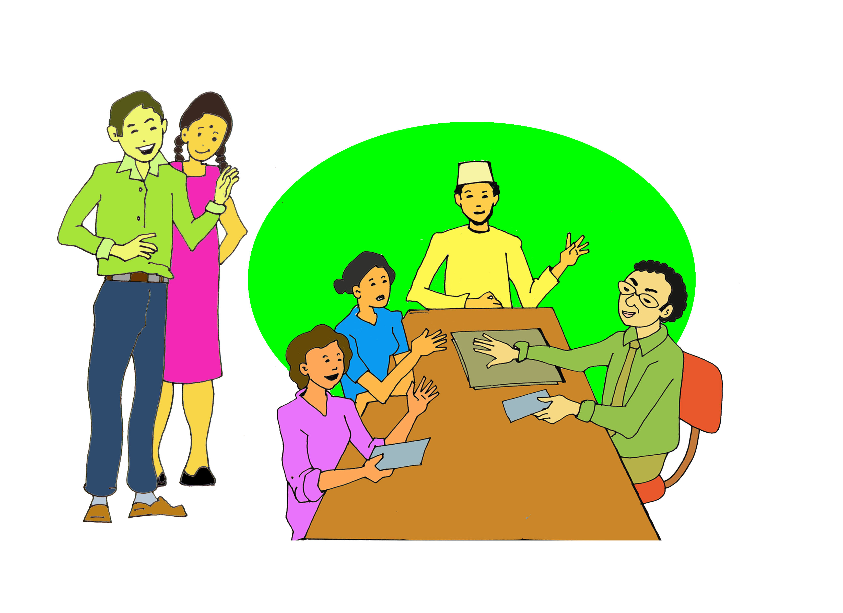
Sites of decision making
Places where groups might want to participate in decision making:
In your family
In your local area
In your Ethnic community
In refugee led groups and organisation
When meeting with Government departments
When meeting with UN agencies
Notes:
Ask the groups you are working with which sites are most important to them.
You can then help them to identify the most appropriate training for the future.

Slide 10
At a personal level.
This checklist is designed to assist in determining what level of meaningful participation is happening or could be viable for individual refugees. You may have already used it when examining gender equality. It can be adapted for mixed groups, men only or any diverse groups you are working with by changing the wording in the top left hand corner **
** Places where women and girls , or men and boys, or people with a disability would like to participate in decision making | **Barriers to this happening, Why can’t women and girls , or men and boys, or people with a disability participate fully? | What would meaningful participation look like? | What can be done to make this happen?
Notes:
Ask the groups to decide on a specific group, or groups. Ask then work to answer the questions. Tables are available in the Tools and Exercises section.
The answers to these questions can be taken forward to the Strategic Planning Session, Module 14.

